Slide 1
Via-Stripline Modeling
Yifan Ding, Hyunwook Park, and Chulsoon Hwang
10/02/2024

Slide 2
Outline
Last meeting:
Use Q2D to extract the tx-line inductance
Implement the extracted inductance in the model
This week:
Implement the partial inductance and the tx-line inductance in more cases (with larger antipad)
Tune L and R for different stackups
Check the G effect → check E and H field

Slide 3
Last week’s results: Change Cavity Height
Via r = 5mil
Case | Via r [mil] | Antipad r [mil] | Cavity height [mil] | Stripline length [mil]
1 (reference) | 5 | 15 | 12 | 200
2 | 5 | 15 | 12 | 100
3 | 5 | 15 | 12 | 500
4 | 5 | 15 | 12 | 10
5 | 5 | 15 | 12 | 1
6 | 5 | 15 | 8 | 200
7 | 5 | 15 | 20 | 200
8 | 5 | 10 | 12 | 200
9 | 5 | 20 | 12 | 200
10 | 2 | 15 | 12 | 200
11 | 10 | 15 | 12 | 200
12 (from Natalia)
Stripline
t = 1mil
12mil
200mil
Antipad r = 15mil
If use the partial inductance, when cavity height changes, the inductance of the tx-line in the antipad region wouldn’t change.
If use the tx-line inductance, when cavity height changes, the inductance of the tx-line in the antipad region will change.

Slide 4
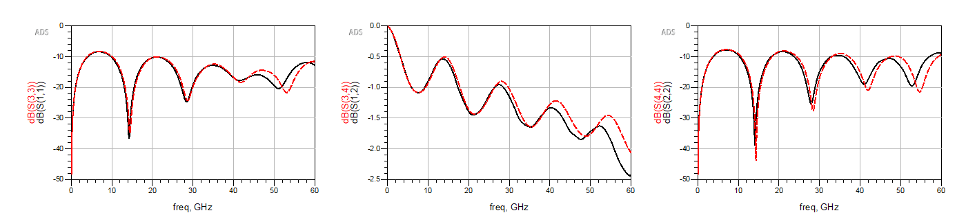
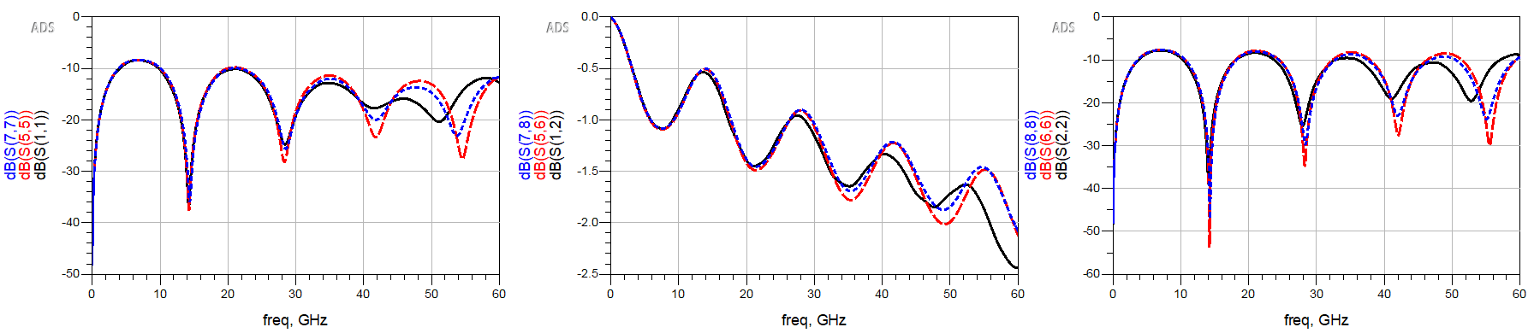
Cavity height = 12mil
HFSS
L @ 60GHz = 65 pH
With partial inductance
S11
S12
S22
With tx-line L
HFSS
L @ 60GHz = 50.15 pH
L @ 0GHz = 59.18 pH
S11
S12
S22

Slide 5
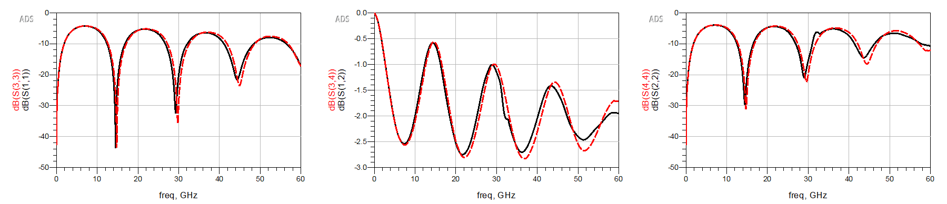
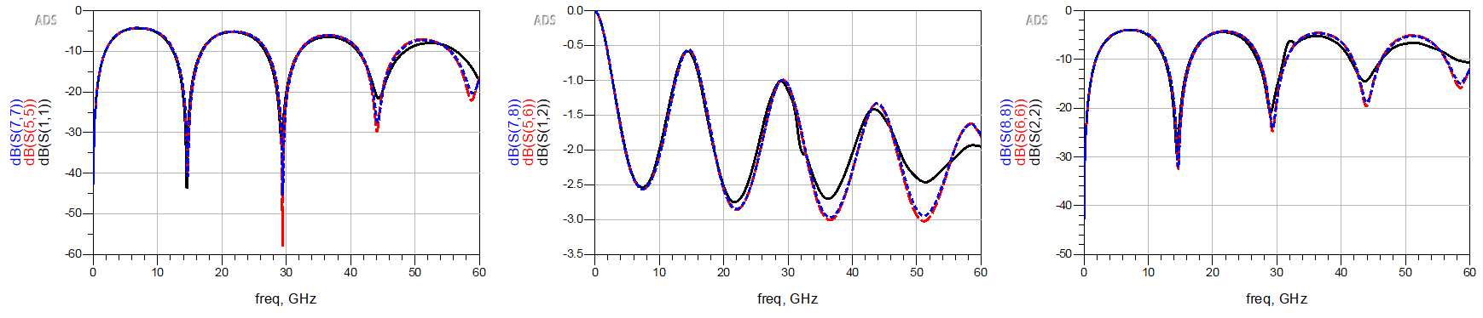
Cavity height = 8mil
HFSS
L @ 60GHz = 65 pH
With partial inductance
S11
S12
S22
HFSS
L @ 60GHz = 39.32 pH
L @ 0GHz = 43.94 pH
With tx-line L
S11
S12
S22

Slide 6
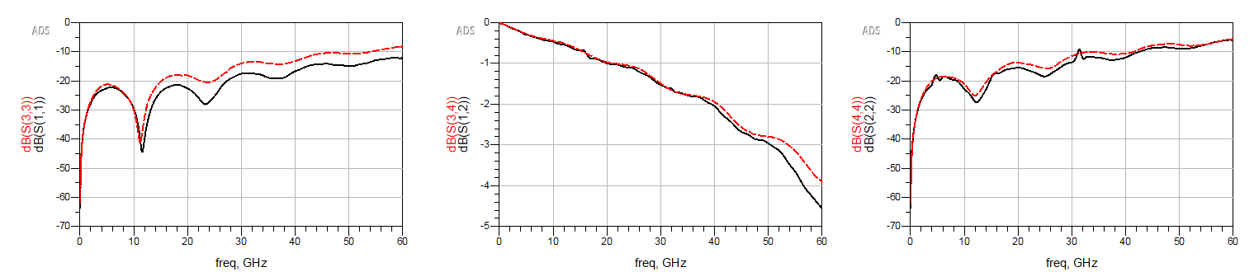
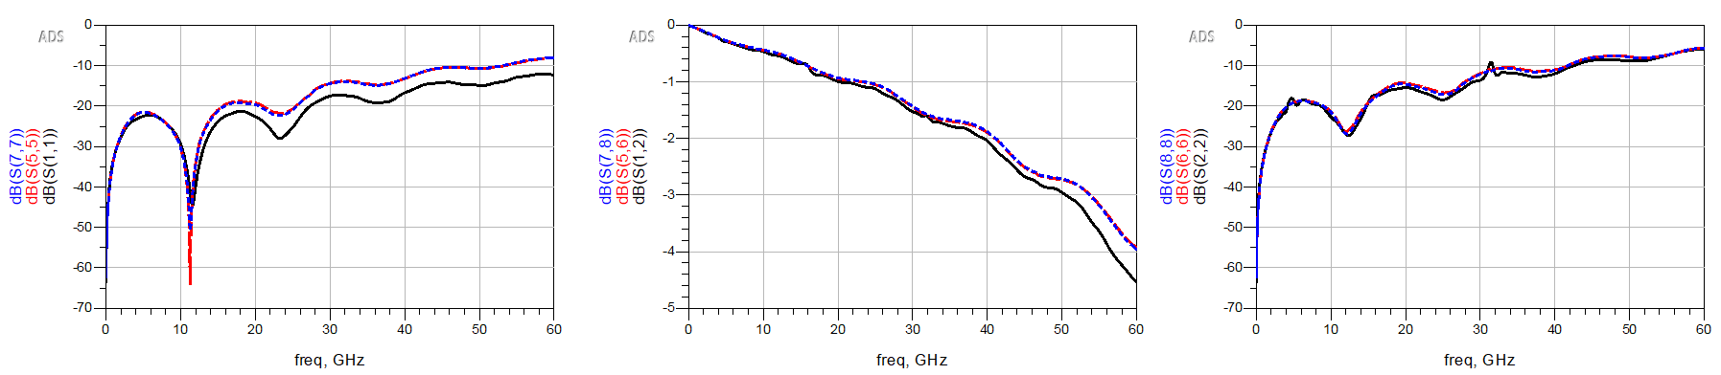
Cavity height = 20mil
HFSS
L @ 60GHz = 65 pH
With partial inductance
S11
S12
S22
HFSS
L @ 60GHz = 76.62 pH
L @ 0GHz = 81.15 pH
With tx-line L
S11
S12
S22

Slide 7
Test Cases
Case | Via r [mil] | Antipad r [mil] | Cavity height [mil] | Stripline length [mil] | Partial L | Tx-line |  | Tunned
 |  |  |  |  |  | L | R | L | R
1 | 5 | 15 | 12 | 200 | 65 pH | 50.15 pH | 0.0532 Ohm | 73.04 pH | 0.698 Ohm
2 | 5 | 15 | 12 | 100 | 65 pH | 50.15 pH | 0.0532 Ohm | 72.18 pH | 0.764 Ohm
3 | 5 | 15 | 12 | 500 | 65 pH | 50.15 pH | 0.0532 Ohm | 75.58 pH | 0.900 Ohm
4 | 5 | 15 | 12 | 10 | 65 pH | 50.15 pH | 0.0532 Ohm | 69.45 pH | 0.676 Ohm
5 | 5 | 15 | 12 | 1 | 65 pH | 50.15 pH | 0.0532 Ohm | 43.06 pH | 0.065 Ohm
6 | 5 | 15 | 8 | 200 | 65 pH | 39.32 pH | 0.0541 Ohm | 51.56 pH | 0.024 Ohm
7 | 5 | 15 | 20 | 200 | 65 pH | 76.62 pH | 0.0515 Ohm | 111.62 pH | 1.150 Ohm
8 | 5 | 10 | 12 | 200 | 21.56 pH | 27.23 pH | 0.0266 Ohm | 0.67 pH | 1.014 Ohm
9 | 5 | 20 | 12 | 200 | 120.12 pH | 81.68 pH | 0.0798 Ohm | 137.78 pH | 0.650 Ohm
10 | 2 | 15 | 12 | 200 | 144.65 pH | 113.31 pH | 0.1359 Ohm | 110.97 pH | 0.160 Ohm
11 | 10 | 15 | 12 | 200 | 15.34 pH | 16.81 pH | 0.0148 Ohm | 51.03 pH | 1.027 Ohm
Optimization type is Gradient.
Results will be different if the choose different optimization algorithm and different start point.

Slide 8
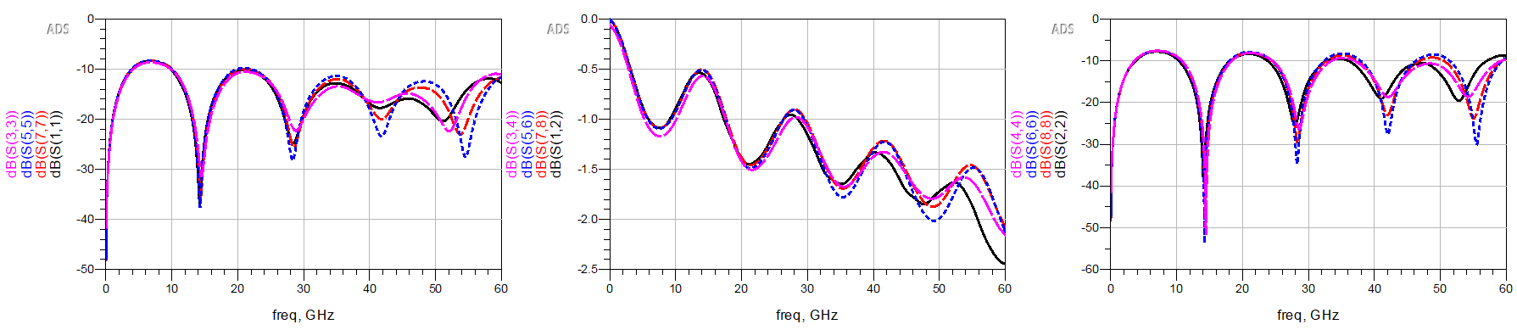
Case 1
Case | Via r [mil] | Antipad r [mil] | Cavity height [mil] | Stripline length [mil] | Partial L | Tx-line |  | Tunned
 |  |  |  |  |  | L | R | L | R
1 | 5 | 15 | 12 | 200 | 65 pH | 50.15 pH | 0.0532 Ohm | 73.04 pH | 0.698 Ohm

Slide 9
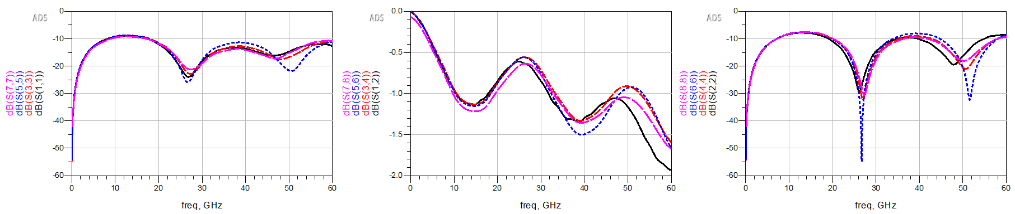
Case 2
Case | Via r [mil] | Antipad r [mil] | Cavity height [mil] | Stripline length [mil] | Partial L | Tx-line |  | Tunned
 |  |  |  |  |  | L | R | L | R
2 | 5 | 15 | 12 | 100 | 65 pH | 50.15 pH | 0.0532 Ohm | 72.18 pH | 0.764 Ohm

Slide 10
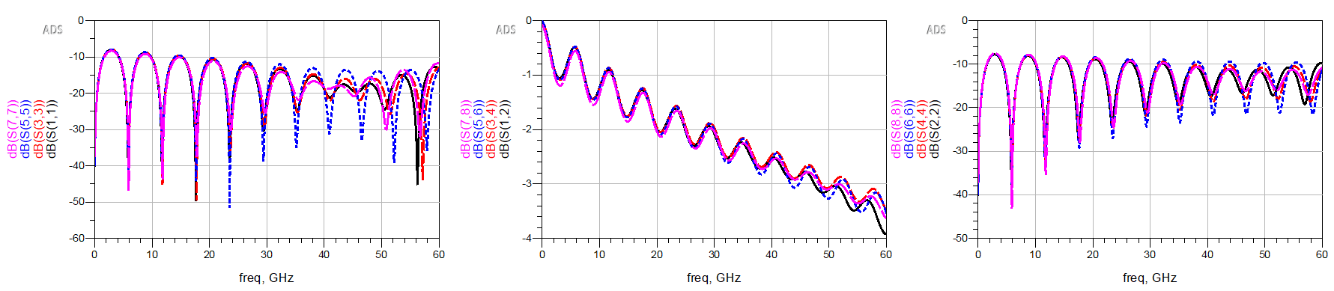
Case 3
Case | Via r [mil] | Antipad r [mil] | Cavity height [mil] | Stripline length [mil] | Partial L | Tx-line |  | Tunned
 |  |  |  |  |  | L | R | L | R
3 | 5 | 15 | 12 | 500 | 65 pH | 50.15 pH | 0.0532 Ohm | 75.58 pH | 0.900 Ohm

Slide 11
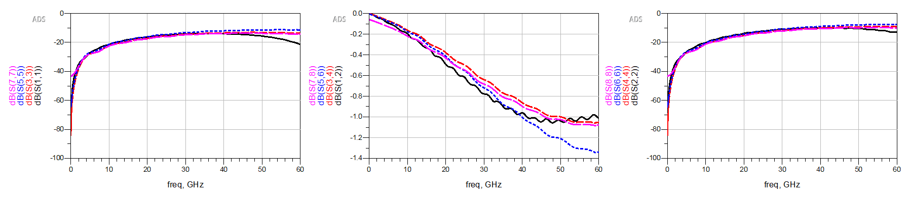
Case 4
Case | Via r [mil] | Antipad r [mil] | Cavity height [mil] | Stripline length [mil] | Partial L | Tx-line |  | Tunned
 |  |  |  |  |  | L | R | L | R
4 | 5 | 15 | 12 | 10 | 65 pH | 50.15 pH | 0.0532 Ohm | 69.45 pH | 0.676 Ohm

Slide 12
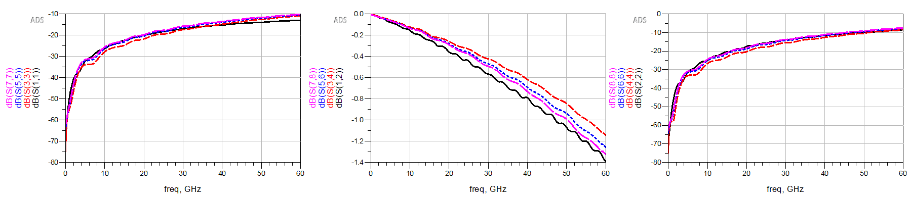
Case 5
Case | Via r [mil] | Antipad r [mil] | Cavity height [mil] | Stripline length [mil] | Partial L | Tx-line |  | Tunned
 |  |  |  |  |  | L | R | L | R
5 | 5 | 15 | 12 | 1 | 65 pH | 50.15 pH | 0.0532 Ohm | 43.06 pH | 0.065 Ohm

Slide 13
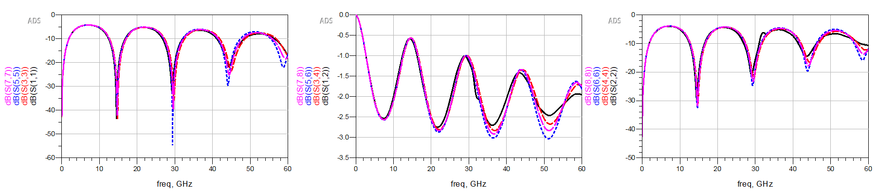
Case 6
Case | Via r [mil] | Antipad r [mil] | Cavity height [mil] | Stripline length [mil] | Partial L | Tx-line |  | Tunned
 |  |  |  |  |  | L | R | L | R
6 | 5 | 15 | 8 | 200 | 65 pH | 39.32 pH | 0.0541 Ohm | 51.56 pH | 0.024 Ohm

Slide 14
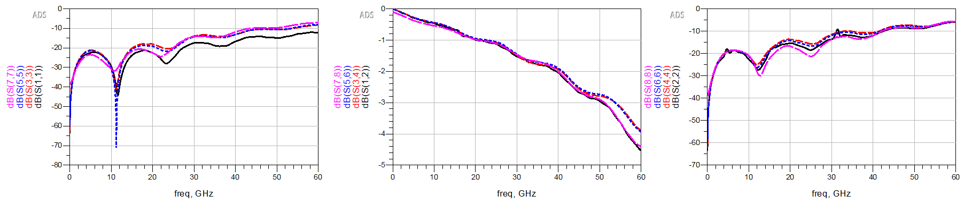
Case 7
Case | Via r [mil] | Antipad r [mil] | Cavity height [mil] | Stripline length [mil] | Partial L | Tx-line |  | Tunned
 |  |  |  |  |  | L | R | L | R
7 | 5 | 15 | 20 | 200 | 65 pH | 76.62 pH | 0.0515 Ohm | 111.62 pH | 1.150 Ohm

Slide 15
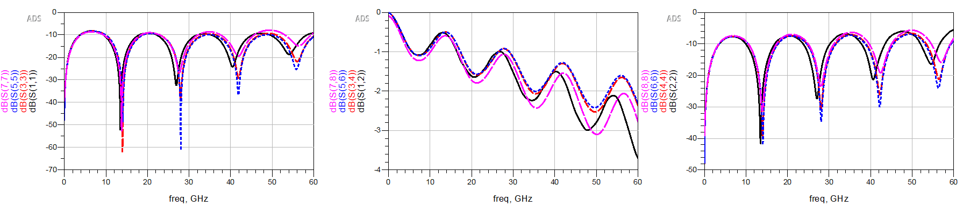
Case 8
Case | Via r [mil] | Antipad r [mil] | Cavity height [mil] | Stripline length [mil] | Partial L | Tx-line |  | Tunned
 |  |  |  |  |  | L | R | L | R
8 | 5 | 10 | 12 | 200 | 21.56 pH | 27.23 pH | 0.0266 Ohm | 0.67 pH | 1.014 Ohm

Slide 16
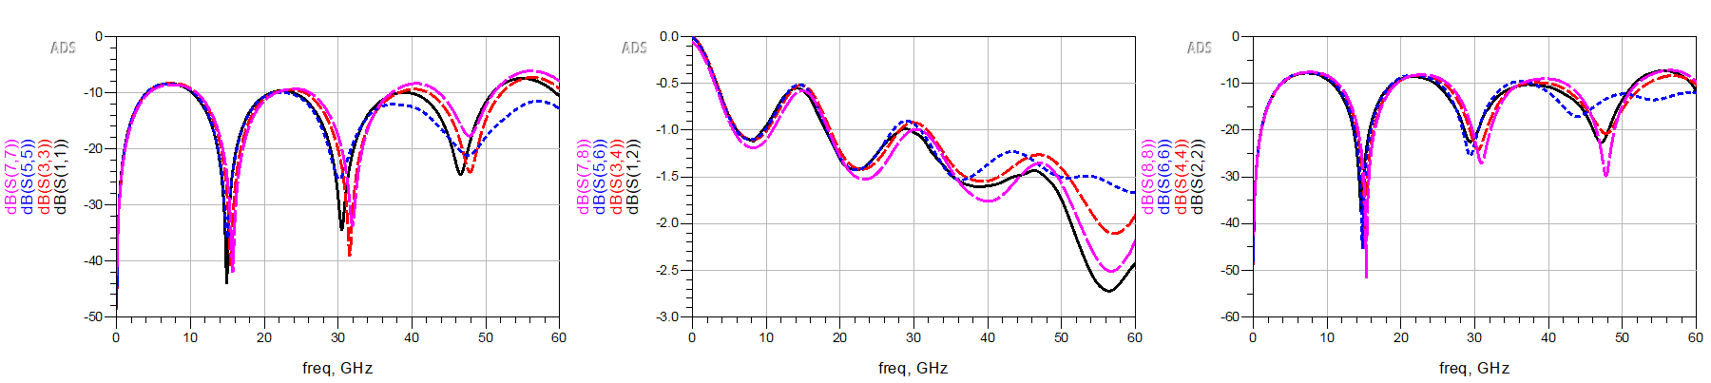
Case 9
Case | Via r [mil] | Antipad r [mil] | Cavity height [mil] | Stripline length [mil] | Partial L | Tx-line |  | Tunned
 |  |  |  |  |  | L | R | L | R
9 | 5 | 20 | 12 | 200 | 120.12 pH | 81.68 pH | 0.0798 Ohm | 137.78 pH | 0.650 Ohm

Slide 17
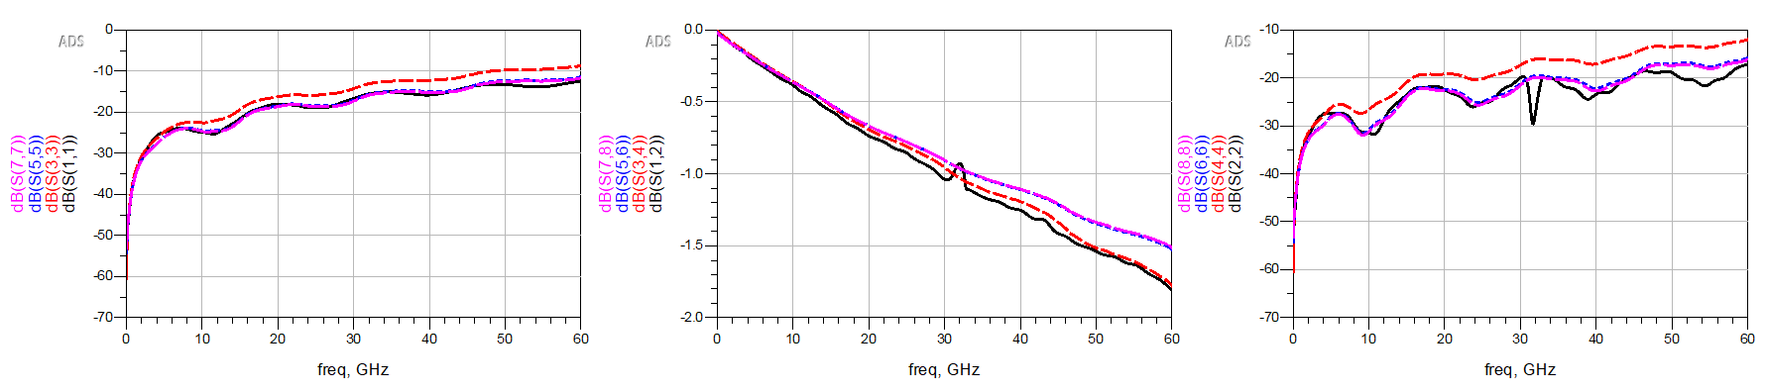
Case 10
Case | Via r [mil] | Antipad r [mil] | Cavity height [mil] | Stripline length [mil] | Partial L | Tx-line |  | Tunned
 |  |  |  |  |  | L | R | L | R
10 | 2 | 15 | 12 | 200 | 144.65 pH | 113.31 pH | 0.1359 Ohm | 110.97 pH | 0.160 Ohm

Slide 18
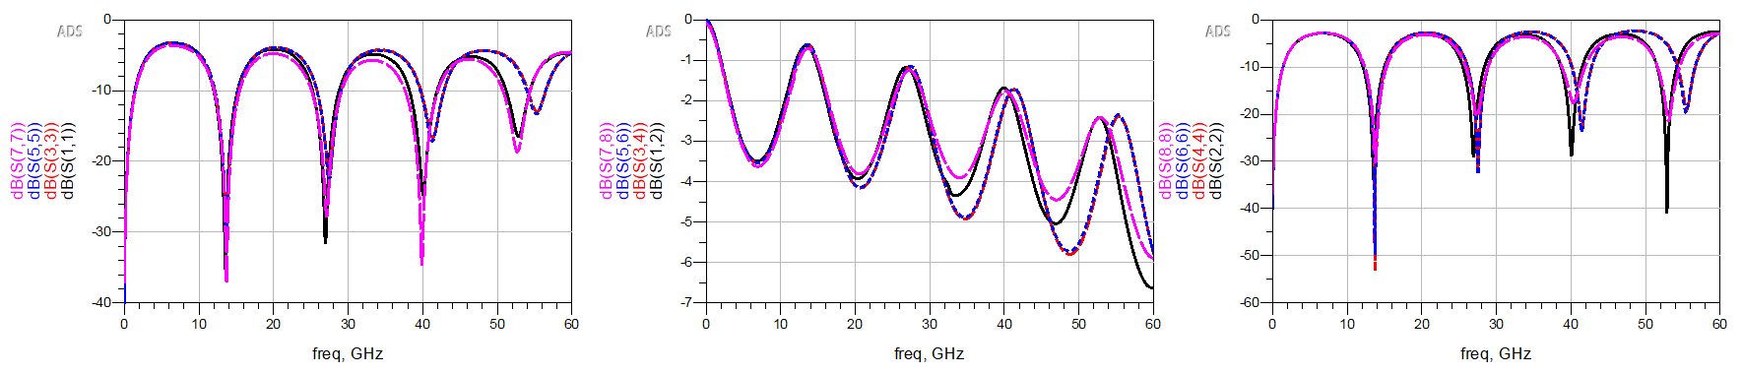
Case 11
Case | Via r [mil] | Antipad r [mil] | Cavity height [mil] | Stripline length [mil] | Partial L | Tx-line |  | Tunned
 |  |  |  |  |  | L | R | L | R
11 | 10 | 15 | 12 | 200 | 15.34 pH | 16.81 pH | 0.0148 Ohm | 51.03 pH | 1.027 Ohm

Slide 19
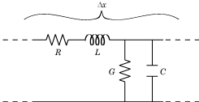
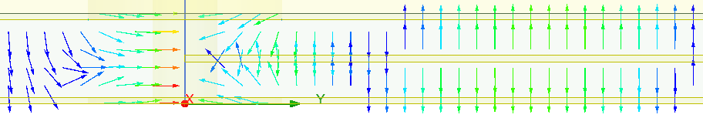
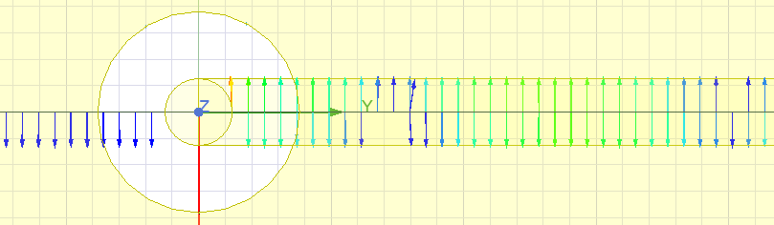
What should be included?
E-field @ 60GHz
CG in the antipad region is different from the tx-line CG
Side view
H-field @ 60GHz
Top view
RL in the antipad region is similar as the tx-line RL

Slide 20
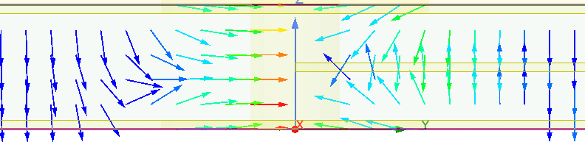
Plate-stripline Capacitance in the Antipad Region
E-field @ 60GHz
C_via
C_str
C_str
C_via

Slide 21
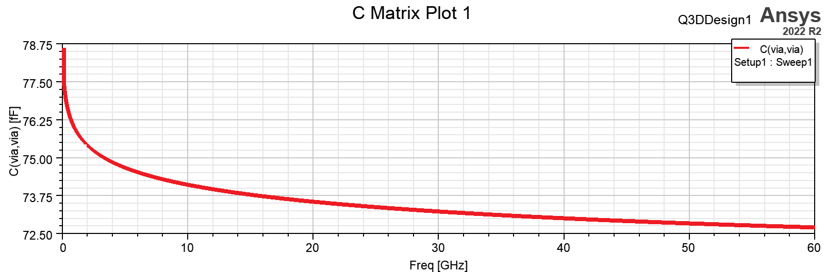
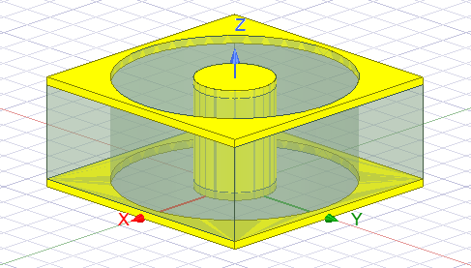
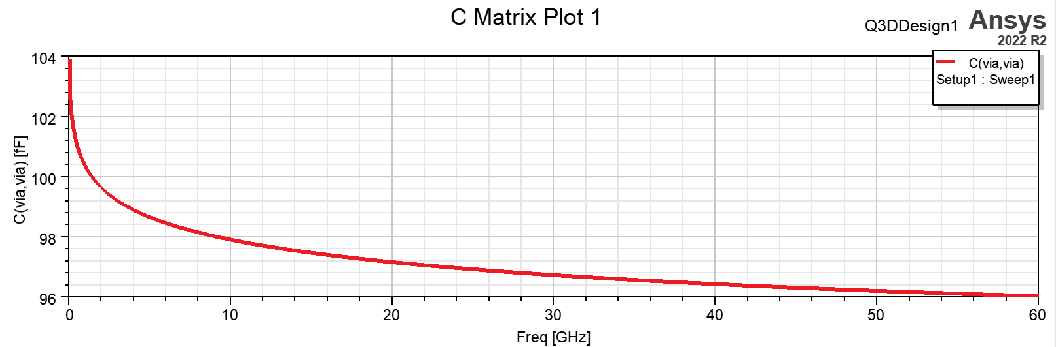
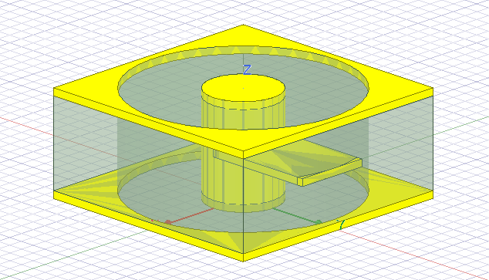
Q3D Capacitance Simulation
From the calculation in via model: C_top + C_bottom = 62.67 fF
Only via
ΔC @ 60GHz = 23.33 fF
Via + stripline

Slide 22
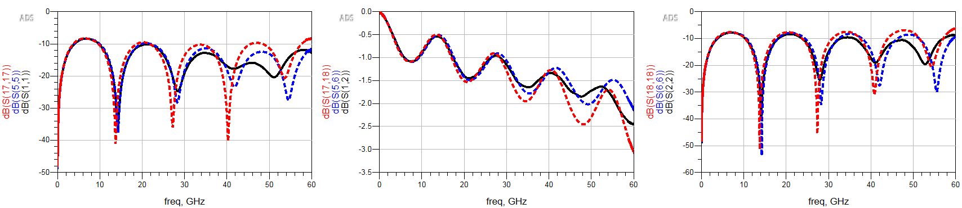
Add the additional capacitance to the via-stripline model
HFSS
With tx-line RL
With tx-line RL + additional C

Slide 24
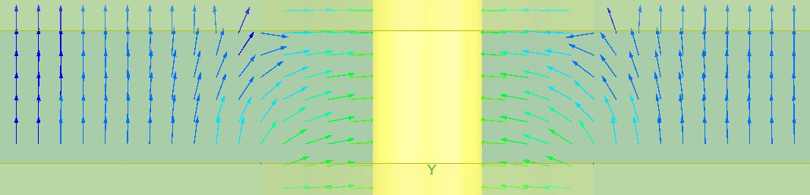
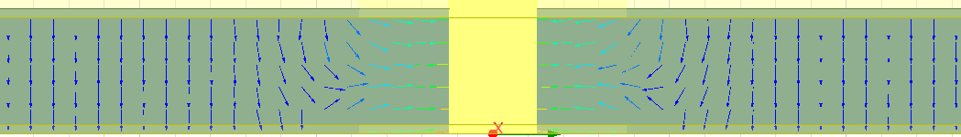
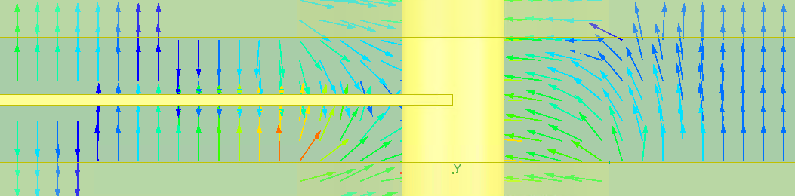
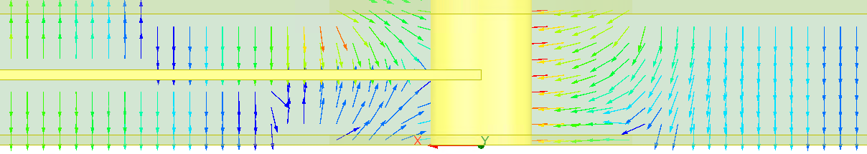
Check the E-Field (@60GHz)
Via only
(with top and bottom ports)
Via only
(with only top port)
Via + Stripline
(with top and bottom ports)
Via + Stripline
(with only top port)

Slide 25
Check the H-Field (@60GHz)

Slide 26
Change Cavity Height
Via r = 5mil
Case | Via r [mil] | Antipad r [mil] | Cavity height [mil] | Stripline length [mil]
1 (reference) | 5 | 15 | 12 | 200
2 | 5 | 15 | 12 | 100
3 | 5 | 15 | 12 | 500
4 | 5 | 15 | 12 | 10
5 | 5 | 15 | 12 | 1
6 | 5 | 15 | 8 | 200
7 | 5 | 15 | 20 | 200
8 | 5 | 10 | 12 | 200
9 | 5 | 20 | 12 | 200
10 | 2 | 15 | 12 | 200
11 | 10 | 15 | 12 | 200
Stripline
t = 1mil
12mil
200mil
Antipad r = 15mil

Slide 27
Cavity height = 15mil
HFSS
L @ 60GHz = 65 pH
With partial inductance
S11
S12
S22
With tx-line L
HFSS
L @ 60GHz = 50.15 pH
L @ 0GHz = 59.18 pH
S11
S12
S22

Slide 28
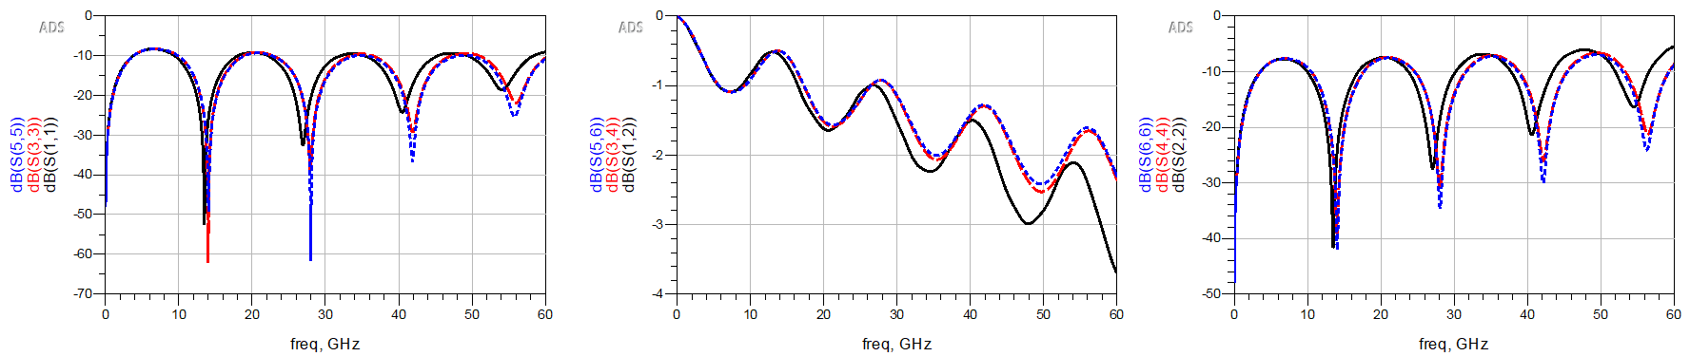
Antipad r = 10 mil
HFSS
L partial @ 60GHz = 21.56398 pH
L tx-line @ 60GHz = 27.23pH, R tx-line @ 60GHz = 26.6mOhm

Slide 29
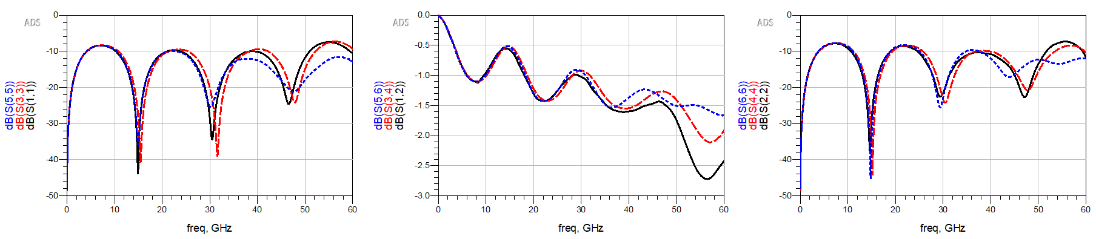
Antipad r = 20 mil
HFSS
L partial @ 60GHz = 120.12 pH
L tx-line @ 60GHz = 81.68pH, R tx-line @ 60GHz = 79.81mOhm

Slide 30
Change via radius
Via r = 5mil
Case | Via r [mil] | Antipad r [mil] | Cavity height [mil] | Stripline length [mil]
1 (reference) | 5 | 15 | 12 | 200
2 | 5 | 15 | 12 | 100
3 | 5 | 15 | 12 | 500
4 | 5 | 15 | 12 | 10
5 | 5 | 15 | 12 | 1
6 | 5 | 15 | 8 | 200
7 | 5 | 15 | 20 | 200
8 | 5 | 10 | 12 | 200
9 | 5 | 20 | 12 | 200
10 | 2 | 15 | 12 | 200
11 | 10 | 15 | 12 | 200
Stripline
t = 1mil
12mil
200mil
Antipad r = 15mil

Slide 31
Via r = 5mil
HFSS
L @ 60GHz = 65 pH
With partial inductance
S11
S12
S22
With tx-line L
HFSS
L @ 60GHz = 50.15 pH
L @ 0GHz = 59.18 pH
S11
S12
S22

Slide 32
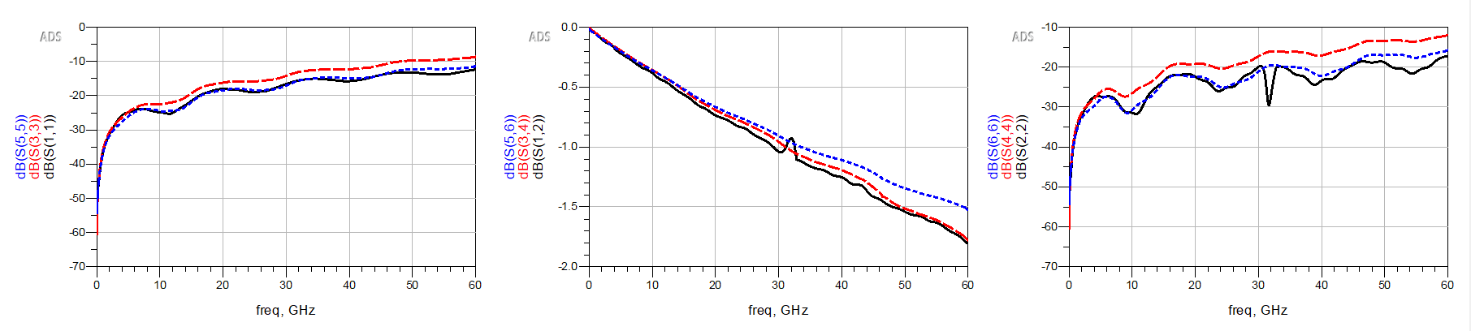
Via r = 2mil
HFSS
L partial @ 60GHz = 144.65pH
L tx-line @ 60GHz = 113.31pH, R tx-line @ 60GHz = 131.59mOhm

Slide 33
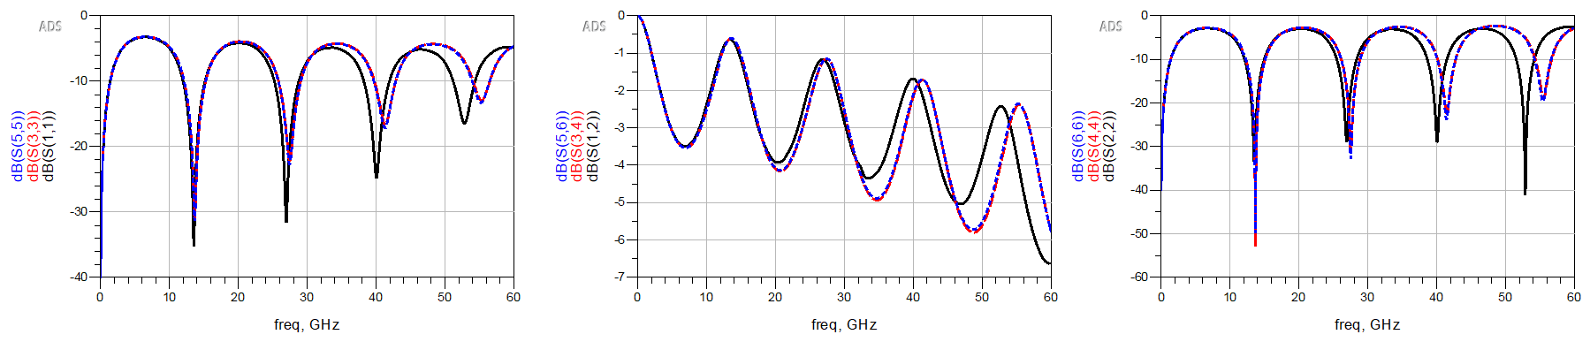
Via r = 10mil
HFSS
L partial @ 60GHz = 15.34pH
L tx-line @ 60GHz = 16.81pH, R tx-line @ 60GHz = 14.82mOhm

Slide 37
Outline
Last meeting:
Implement the partial inductance in the model to represent the stripline in the anti-pad region.
Missing mutual coupling for differential pair
Calculate the tx-line inductance
L extracted from the MATLAB function has strange behavior
This week:
Use Q2D to extract the tx-line inductance
Implement the extracted inductance in the model

Slide 38
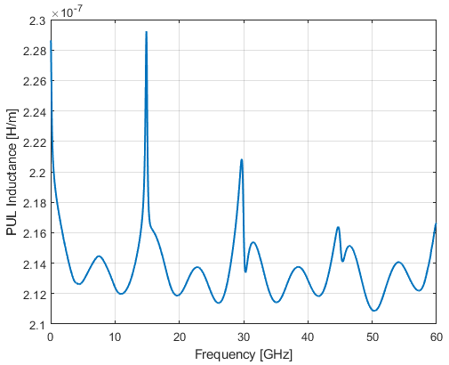
Previous Results: Obtain L from Stripline RLGC
Partial inductance used in the current model = 65 pH
@ 60GHz
R_pul = 1.6187e+03 Ω/m
L_pul = 2.1665e-07 H/m
G_pul = 2.1665e-07 S/m
C_pul = 2.1665e-07 F/m
@ 60GHz * 10mil
L = 2.1665e-07 H/m *10 mil
= 55.028 pH
*From the MATLAB s2rlgc conversion function

Slide 39
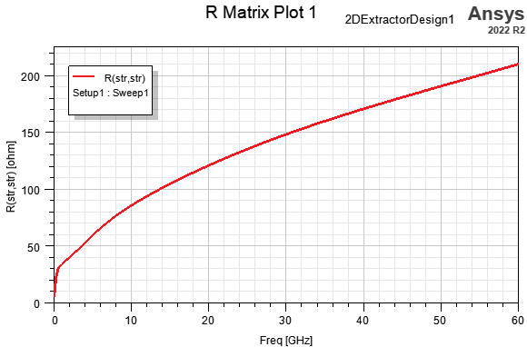
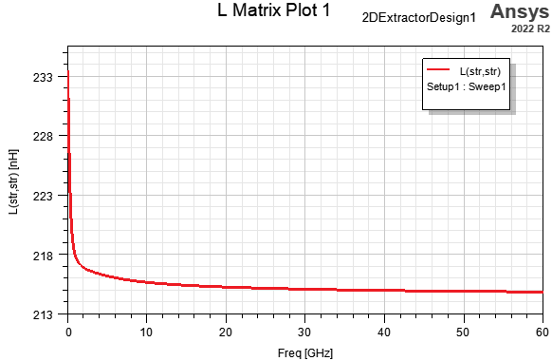
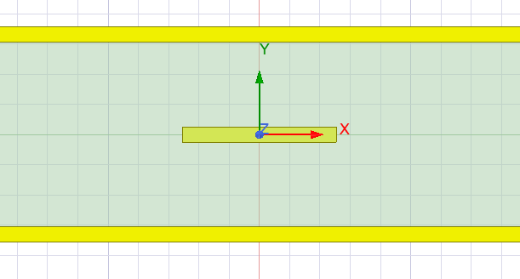
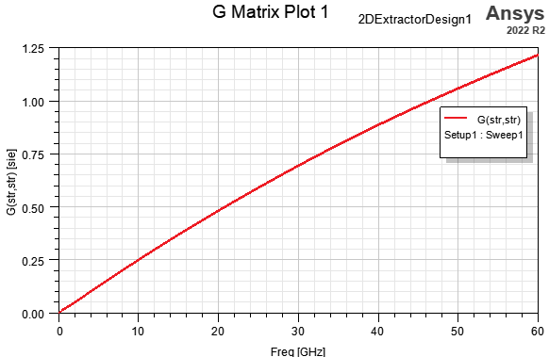
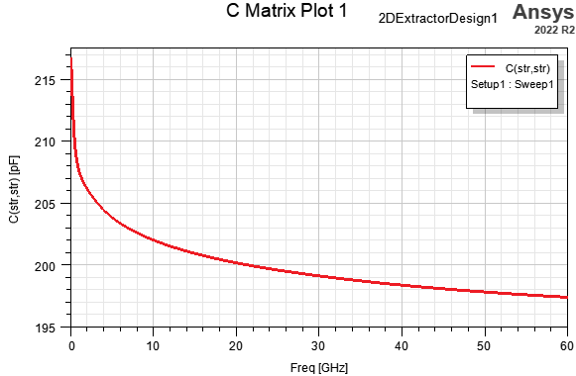
RLGC Extraction – Q2D Simulation
@ 0GHz * 10mil
L = 232.92 nH/m *10 mil
= 59.18 pH
1 mil
10 mil
@ 60GHz * 10mil
L = 214.38 nH/m *10 mil
= 50.15 pH
@ 60GHz * 10mil
R = 209.49 Ohm/m *10 mil
= 53.2 mOhm
@ 60GHz * 10mil
G = 862.0885 mSie/m *10 mil
= 0.219 mSie

Slide 40
Change Cavity Height
Via r = 5mil
Case | Via r [mil] | Antipad r [mil] | Cavity height [mil] | Stripline length [mil]
1 (reference) | 5 | 15 | 12 | 200
2 | 5 | 15 | 12 | 100
3 | 5 | 15 | 12 | 500
4 | 5 | 15 | 12 | 10
5 | 5 | 15 | 12 | 1
6 | 5 | 15 | 8 | 200
7 | 5 | 15 | 20 | 200
8 | 5 | 10 | 12 | 200
9 | 5 | 20 | 12 | 200
10 | 2 | 15 | 12 | 200
11 | 10 | 15 | 12 | 200
12 (from Natalia)
Stripline
t = 1mil
12mil
200mil
Antipad r = 15mil
If use the partial inductance, when cavity height changes, the inductance of the tx-line in the antipad region wouldn’t change.
If use the tx-line inductance, when cavity height changes, the inductance of the tx-line in the antipad region will change.

Slide 41
Cavity height = 12mil
HFSS
L @ 60GHz = 65 pH
With partial inductance
S11
S12
S22
With tx-line L
HFSS
L @ 60GHz = 50.15 pH
L @ 0GHz = 59.18 pH
S11
S12
S22

Slide 42
Cavity height = 8mil
HFSS
L @ 60GHz = 65 pH
With partial inductance
S11
S12
S22
HFSS
L @ 60GHz = 39.32 pH
L @ 0GHz = 43.94 pH
With tx-line L
S11
S12
S22

Slide 43
Cavity height = 20mil
HFSS
L @ 60GHz = 65 pH
With partial inductance
S11
S12
S22
HFSS
L @ 60GHz = 76.62 pH
L @ 0GHz = 81.15 pH
With tx-line L
S11
S12
S22

Slide 44
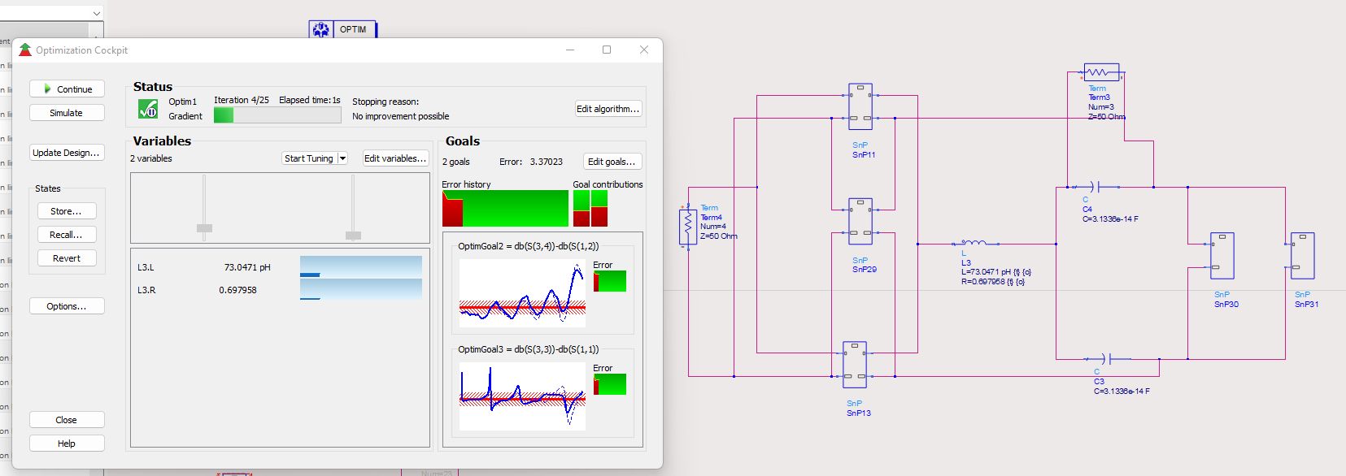
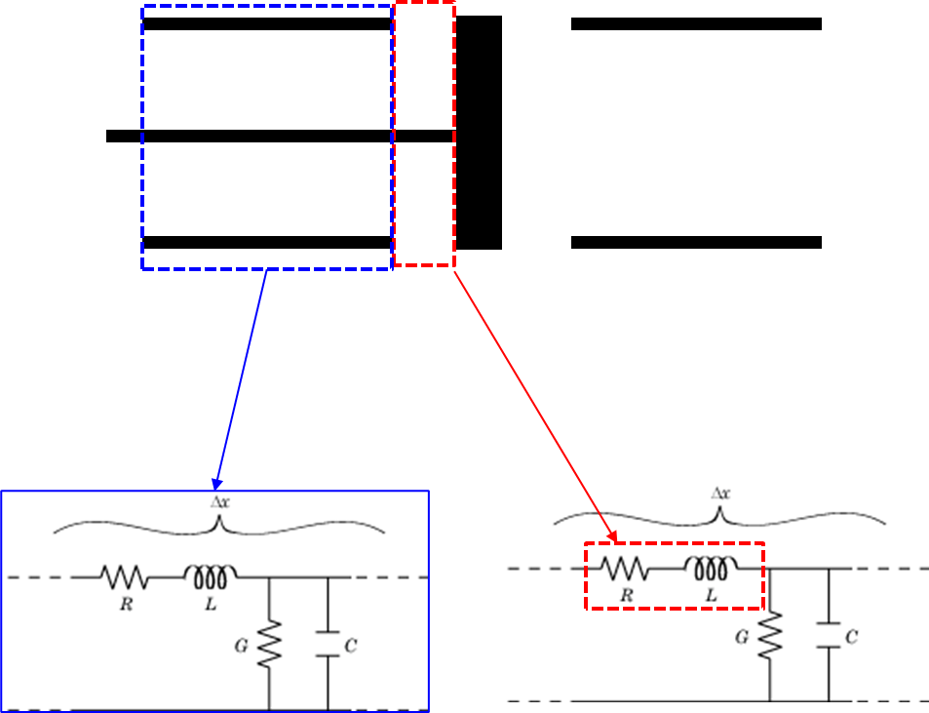
Try to Tune the Parameters
L and R

Slide 45
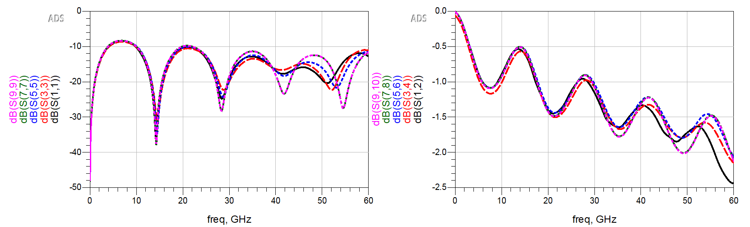
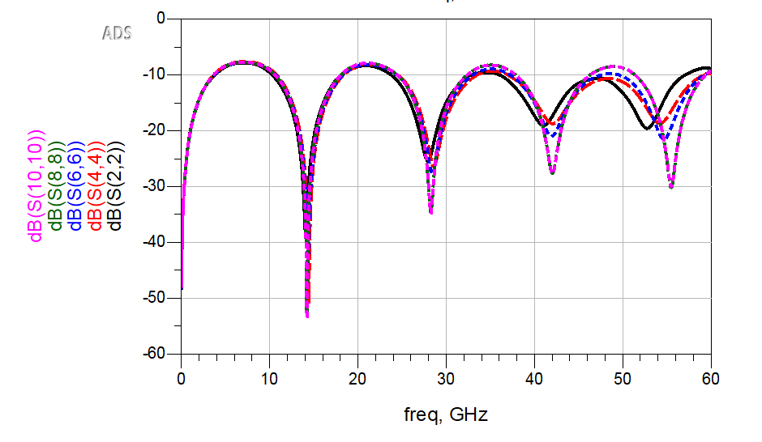
HFSS
Equivalent ckt with tuned L = 73pH R = 0.7Ohm
Equivalent ckt with partial L = 65pH
Equivalent ckt with Tx-line L = 50.15pH
Equivalent ckt with Tx-line L = 50.15pH R = 0.053Ohm

Slide 46
Next Steps
Implement the partial inductance and the tx-line inductance in more cases (with larger antipad)
Check the G effect
Tune L and R for different stackups

